Slide 1
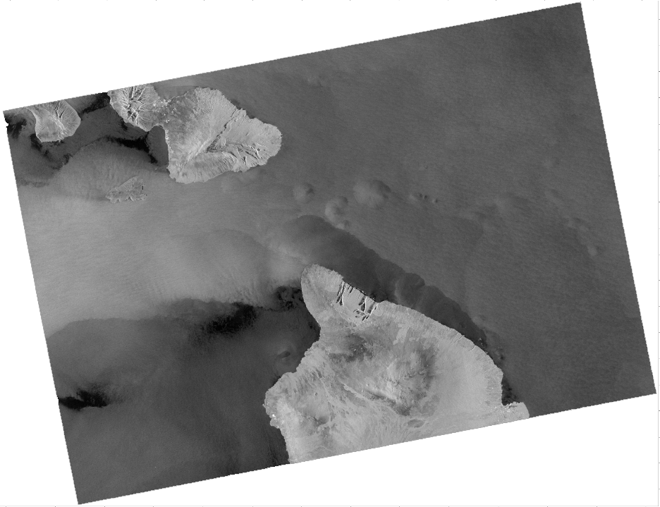

An Overview of Synthetic Aperture Radar
Module 1: Synthetic Aperture Radar Series
NOAA Coastwatch Satellite Courses
Sentinel-1 SAR image
Hawaii 29 May 2022 04:31 UTC
Last Updated: 1/4/2023
coastwatch.info@noaa.gov

Slide 2
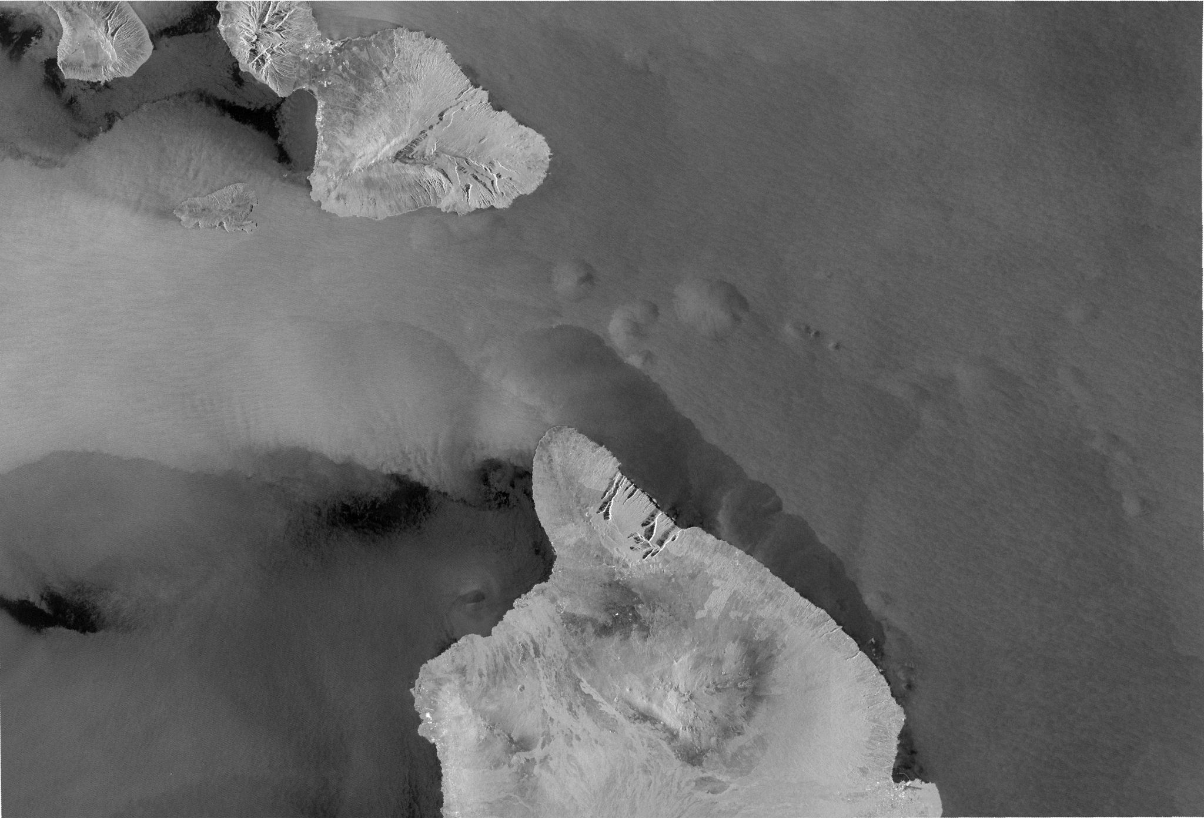
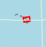
Sentinel-1
C-Band VV image over
Hawaii
29 May 2022 04:31 UTC

Slide 3

The CoastWatch Synthetic Aperture Radar instructional series
The CoastWatch Synthetic Aperture Radar (SAR) instructional series
consists of three (3) training modules:
  Module 1: An overview of SAR (this module)
  Module 2: Descriptions of available SAR products and where to find them
  Module 3: Examples of how various phenomena appear in SAR imagery

Slide 4
Module 1: An overview of Synthetic Aperture Radar (SAR)
Outline
Why should I care about SAR
  What can SAR measure?
  The pros and cons of using SAR
Background
  Radar and how it works
  How is SAR different from standard radar?
SAR specifications
  SAR Frequency Bands
  SAR Polarization
Overview of SAR satellite missions and products

Slide 5
What can be detected by SAR?
Oceanic
  Surface Waves
    Significant Wave Height
    Wave Spectra
Surfactants (Biogenic Slicks,
Oil Seeps)
Sea Ice
  Internal Waves
  Currents and Fronts
  Eddies
  Upwelling
  Underwater Topography
Atmospheric
  Surface Wind
  Convection Cells / Rolls
  Storm Systems
  Vortex Streets
  Gravity Waves
  Rain Cells / Thunderstorms
Anthropogenic
  Hard Targets (Ships/Oil Platforms)
  Ship Wakes
  Pollution (Oil Spills)
Coastal / Land
  Flooding and Inundation
  Shorelines
  Land Use
  Land Deformation (interferometry)
  Burn Scar Identification
…there are many other applications

Slide 6
The pros and cons of SAR measurements
SAR Advantages
  Data collection is independent of lighting and cloud conditions
  Wide area coverage (100–450 km swath)
  High resolution coverage (30-100 m)
  Fine resolution is available (1m-3m)
  Many different products can be derived
SAR Disadvantages
  Expertise is required to interpret the data
  Specialized software to read and calibrate
  Scheduled data acquisitions limit global coverage
Traditional barriers
  Cost - free access is now available
  Difficulty in reading and interpreted data
  Irregular temporal revisit times

Slide 7
What’s RADAR?
The acronym RADAR stands for RAdio Detection And Ranging
  Any system that actively sends electromagnetic microwaves from a satellite
  or an aircraft (or police car) and detects the return signal
Ranging refers to measuring distance
  The distance from the sensor to the target
Radars are active instruments, sending signals to Earth’s surface.
  They do not depend on solar illumination, so radar observations are possible both day and night
Radars use microwaves, which penetrate through clouds and rain
  Wavelengths are between a few millimeters up to 1 meter
  Radar observations are possible regardless of cloud cover

Slide 8
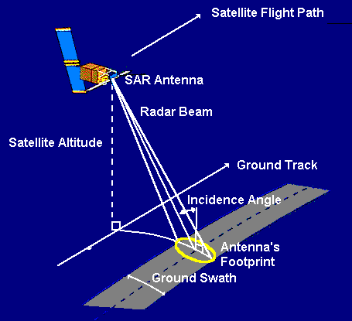
RADAR is composed of a transmitter, a receiver, an antenna, and an electronic system
The transmitter generates pulses of microwaves at regular intervals, which are focused by the antenna into a beam.
The beam illuminates the surface of Earth.
The antenna receives a portion of the transmitted signal that is reflected, or backscattered, from the Earth's surface.
The antenna length is called the aperture.
The electronic system processes and records the data.
https://appliedsciences.nasa.gov/join-mission/training/english/arset-introduction-synthetic-aperture-radar

Slide 9
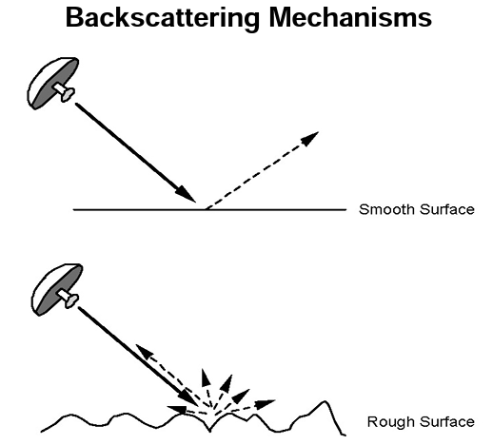
RADAR measures the portion of the transmitter radar energy that is backscattered to the antenna
Smooth surfaces scatter most of the radar energy away from the radar, so less signal is backscattered to the SAR antenna.
These SAR images appear black.
Rough surfaces backscatter more the radar energy back to the SAR antenna.
These SAR images appear brighter
Normalized Radar Cross Section (NRCS) is the measure of radar backscatter
Images from https://appliedsciences.nasa.gov/join-mission/training/english/arset-introduction-synthetic-aperture-radar

Slide 10
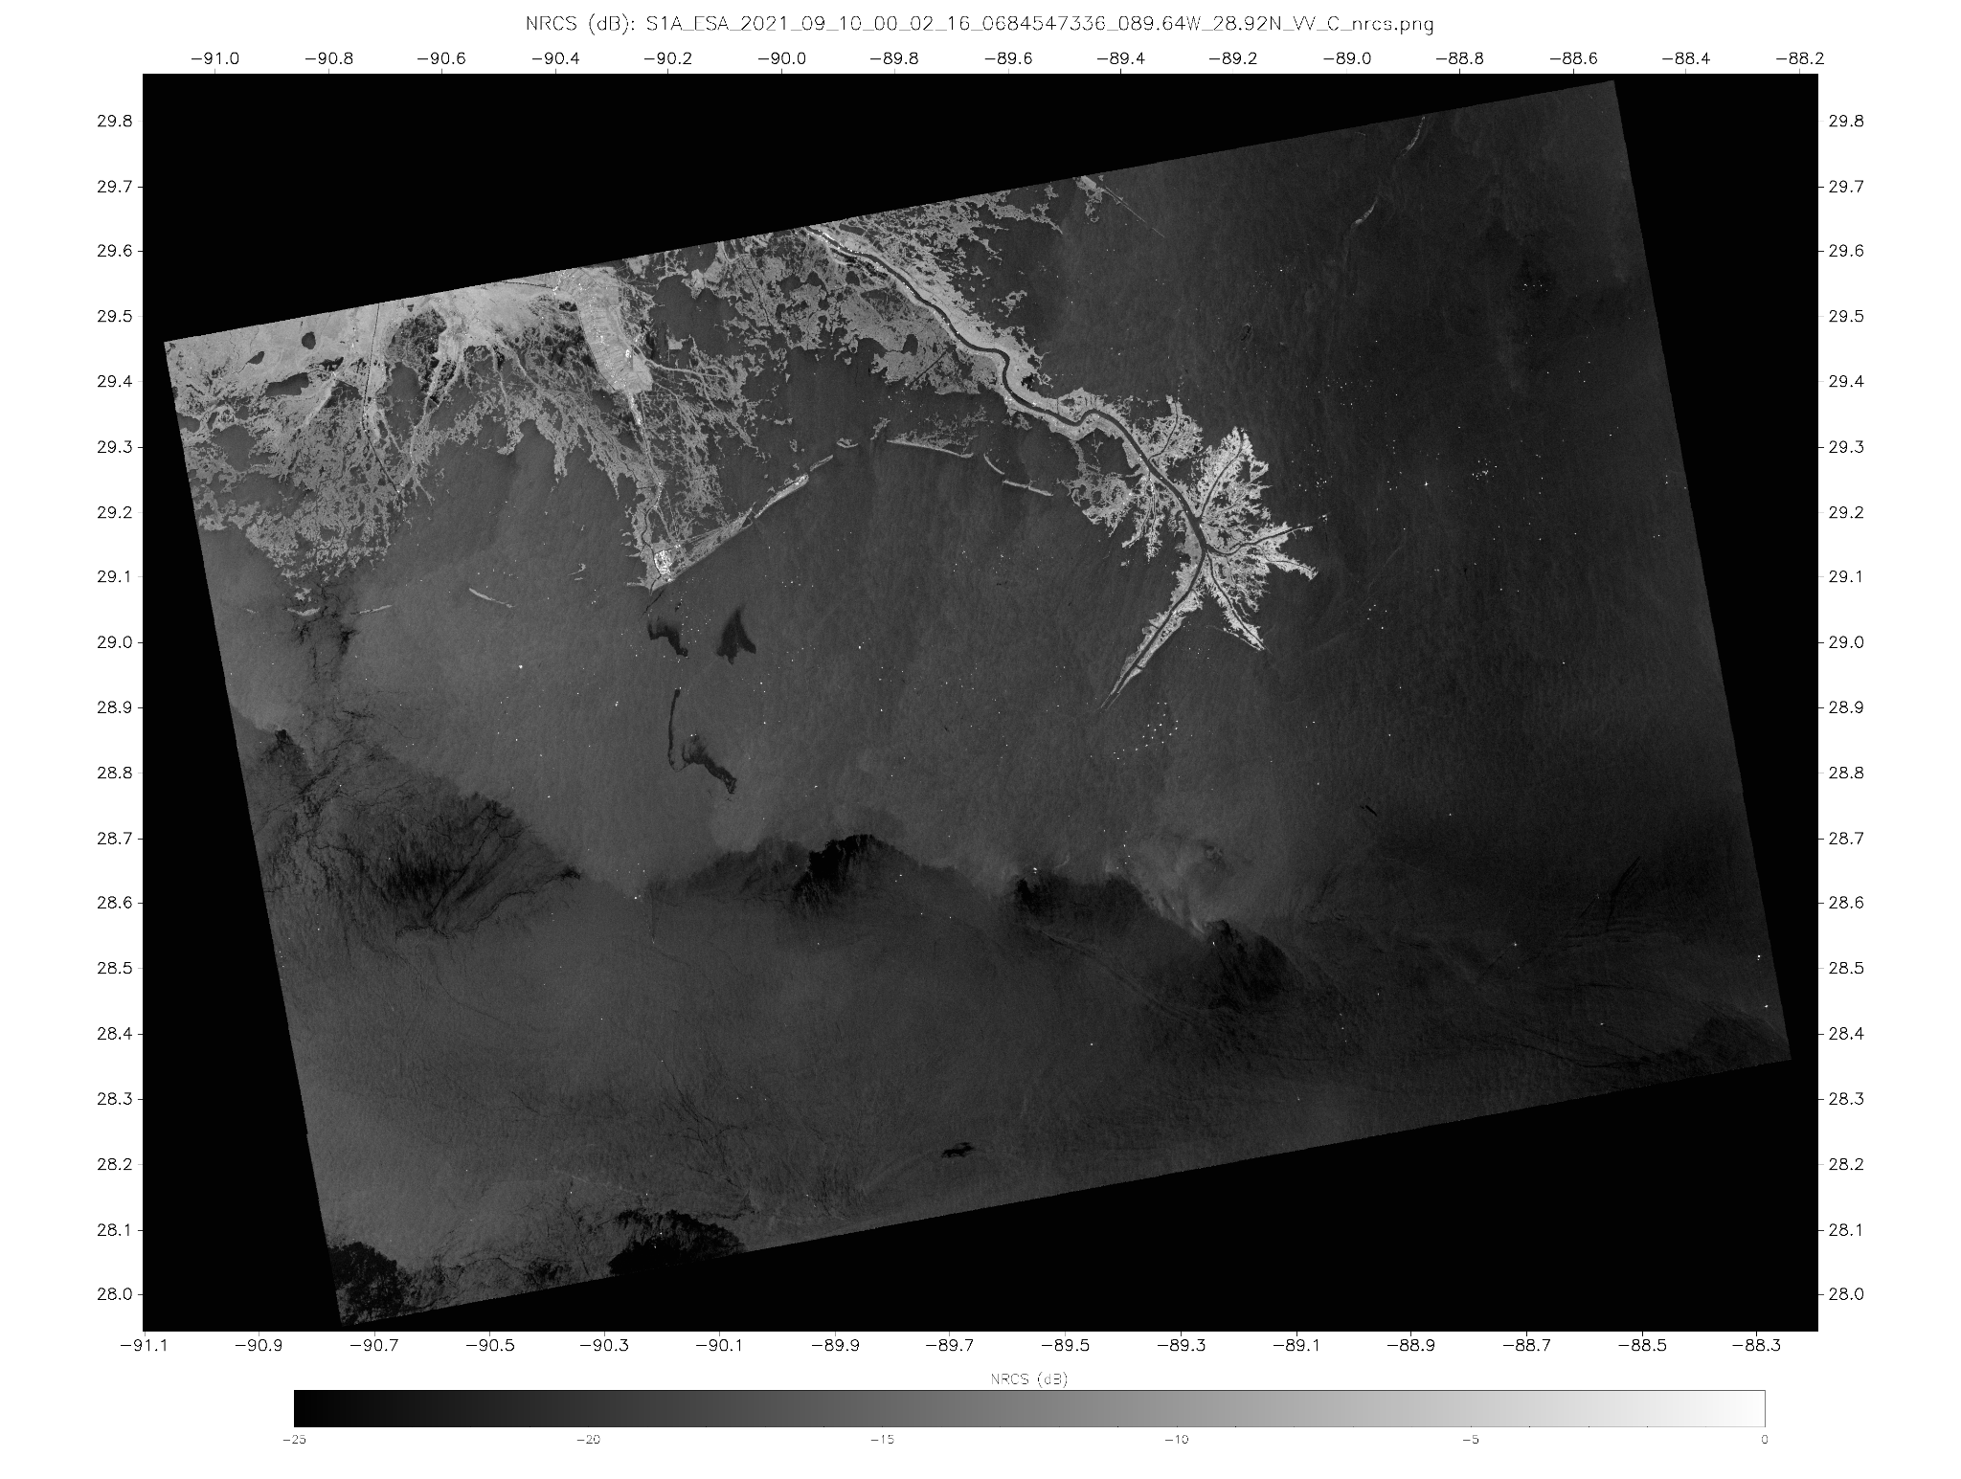
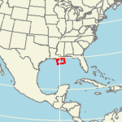
SAR image over the Gulf of Mexico
High backscatter (bright)
Land, Oil Platforms
Low backscatter (dark)
Ocean surface with oil or low winds
Moderate backscatter (gray)
Ocean surface with moderate wind speeds (5-8 m/s)
Oil Spills
Higher Wind Area (behind front)
Oil Platforms
Atmospheric Front Boundary
Biogenic Slicks
Lower Wind Area (ahead of front)
Sentinel-1 VV SAR Image,
10 September 2021 00:02 UTC,
Bird’s Foot Delta - Gulf of Mexico

Slide 11
Components of ocean surface roughness contributing to backscatter
Wind-generated short waves (Capillary to short gravity waves) have wavelengths
from a few centimeters to tens of centimeters and periods < 1 second
Therefore, radar wavelengths of a few centimeters are needed to
observe ocean surface roughness and thereby obtain a measure of wind speed.
Longer gravity waves, currents, oil slicks, and other phenomena can be identified
by the ways they affect the pattern of the wind-generated short waves.

Slide 12
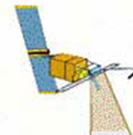
Antenna size and pulse bandwidth determine spatial resolution
Azimuth direction (along-track)
Spatial resolution depends on the beam width
Beam width is inversely proportional
to the antenna length.
A longer antenna (aperture) produces
a narrower beam and a finer resolution
Range direction (perpendicular to along-track)
Spatial resolution depends on the bandwidth
of the signal pulse
Signal pulse length can be controlled for specific applications
Satellite flight
vector
=
Azimuth
Range
Satellite Track
SAR systems are side-looking
Image modified from
https://earth.esa.int/eogateway/missions/ers/radar-courses/radar-course-1

Slide 13
High-resolution radar imagery requires a very large antenna
For a “real” aperture radar
Range resolution is on the order of meters
a 100 MHz bandwidth pulse produces a resolution of ~ 1.5 meters
Azimuth resolution is on the order of kilometers
a 12 meter antenna operating at 5 GHz gives a beam width of ~ ¼ degree
At 700 km altitude this is ~3.5km on the ground
The produce an azimuth resolution of 30 meters would require an antenna a few kilometers long
It is not feasible to have a long (physical) antenna in space.
In a “synthetic” aperture radar (SAR) signal processing combines many individual radar pulses to “synthesize” a larger antenna.

Slide 14
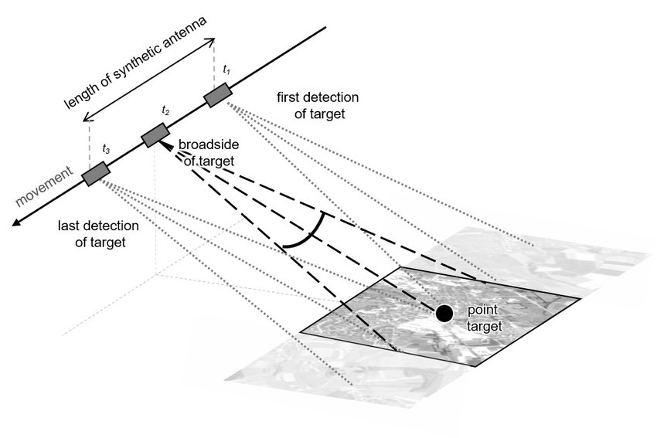
How a synthetic aperture is created
Signals are transmitted to and received from the same object from successive sensor positions along the orbital path (t1, t2, t3 on the figure).
Signals from successive sensor positions are coherently (preserved amplitude and phase) combined.
The length of the orbit path where the object is observed is the synthetic aperture (length of the synthetic antenna).
length of synthetic antenna
t₁
t₂
t₃
https://up42.com/blog/tech/sar-data-complementary-optical

Slide 15
Recap of Synthetic Aperture Radar
SAR is an active sensor that transmits a radar pulse to the earth's surface
and records the energy reflected back to the sensor (backscatter).
The returned signals are coherently combined over a time interval
to produce a 2D image of the normalized radar cross section
The distance the radar sensor travels in this time interval is the synthetic aperture length.
The synthetic aperture is much larger than the “real” antenna aperture
allowing fine resolution in the azimuth (flight track) direction
  Azimuth resolution is proportional to the wavelength (λ) over radar aperture (L), i.e. λ/L
  Range resolution is determined by the bandwidth of the radar pulse
Radars use microwaves (λ = few millimeters - 1 meter), which penetrate through clouds and rain

Slide 16
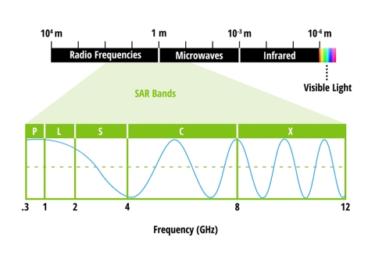
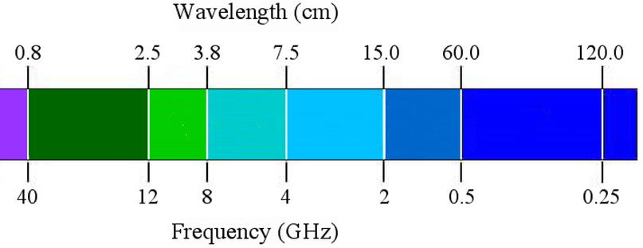
SAR wavelengths are grouped into labelled bands
10⁶ cm
10⁴ cm
10² cm
10⁰ cm
10⁻² cm
10⁻⁴ cm
10⁻⁶ cm
Band | Frequency (GHz) | Wavelength (cm)
X | 8-12 | 2.4-3.8
C | 4-8 | 3.8-7.5
S | 2-4 | 7.5-15
L | 1-2 | 15-30
P | 0.3-1 | 30-100
Radio
Microwave
Infrared
Ultraviolet
Visible
100
30
15
7.5
3.8
2.4
Wavelength (cm)
P
L
S
C
X
0.3
1
2
4
8
12
Frequency (GHz)
The labels were made intentionally confusing to deter spies during World War II.
from https://www.earthdata.nasa.gov/learn/backgrounders/what-is-sar
≠–

Slide 17
Applications of SAR Bands
Band | Frequency | Application | Satellite Based System
X | 8-12 GHz | High resolution SAR (urban monitoring,ice and snow, strong scattering from vegetation cover) | TerraSAR-X, TanDEM-X, COSMO-SkyMed, COSMO-SkyMed (2nd Gen), Iceye, Capella
C | 4-8 GHz | Principle frequency for European and Canadian Systems. (ice, ocean maritime navigation) | Radarsat-2, Radarsat Constellation Mission, Sentinel-1A, ERS-1, ERS-2, Envisat ASAR, Radarsat-1, Sentinel-1B
S | 2-4 GHz | Limited prior usage for earth observation. | NISAR, ALMAZ,
L | 1-2 GHz | Medium resolution SAR (geophysical monitoring; biomass and vegetation mapping; high penetration) | ALOS-2, SAOCOM, NISAR, Seasat, JERS, ALOS,
P | 0.3 - 1 GHz | Biomass. Vegetation mapping and assessment soil moisture
Systems in gray are no longer operational
Modified from https://www.earthdata.nasa.gov/learn/backgrounders/what-is-sar

Slide 18
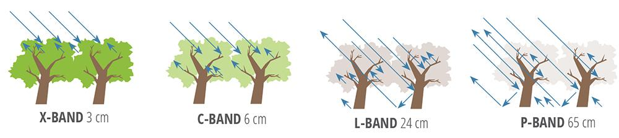
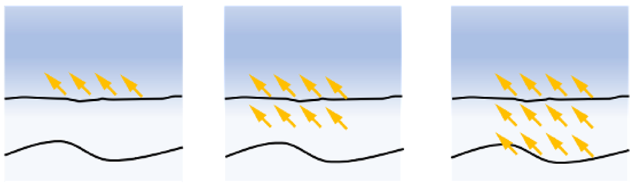
Wavelength changes the penetration depth of the signal
Longer wavelengths allow deeper penetration of the signal
Air
Snow
Sea Ice
X-Band
(λ ca. 3 cm)
C-Band
(λ ca. 6 cm)
L-Band
(λ ca. 23 cm)
https://elib.dlr.de/145667/1/Master_Thesis_Galassi_20210629_Signed.pdf

Slide 19
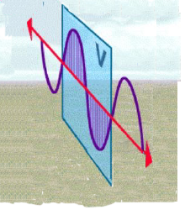
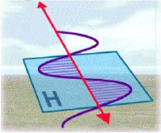
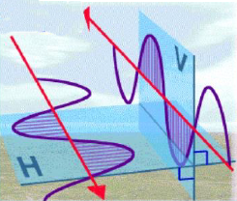
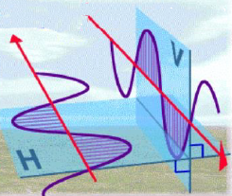
Polarization
DOI:10.1088/1755-1315/71/1/012004
https://www.researchgate.net/figure/The-full-left-and-single-right-polarimetric-SAR-PolSAR-images-and-illustration-of_fig5_317700816
https://creativecommons.org/licenses/by/3.0/
Polarization refers to the orientation of the plane in which the transmitted electromagnetic wave oscillates.
The polarization of the transmitted radar sensor beam can be precisely controlled.
Measurement of the received signal strength in a selected plane of polarization can also be precisely controlled.
How target surfaces interact with or change the polarization of the transmitted beam can help determine physical properties of the target surfaces.
VV: Vertical Transmit, Vertical Receive
HH: Horizontal Transmit, Horizontal Receive
HV: Horizontal Transmit, Vertical Receive
VH: Vertical Transmit, Horizontal Receive

Slide 20
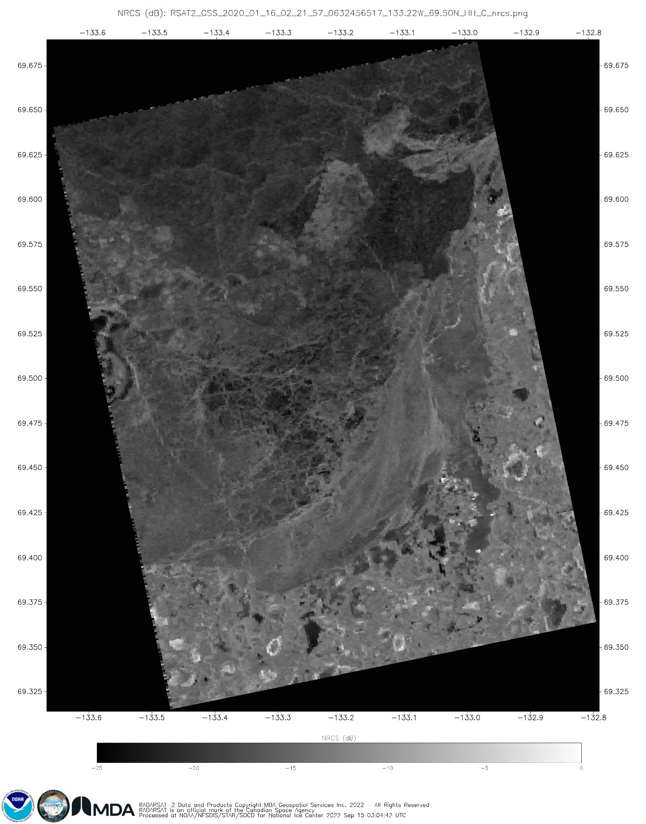
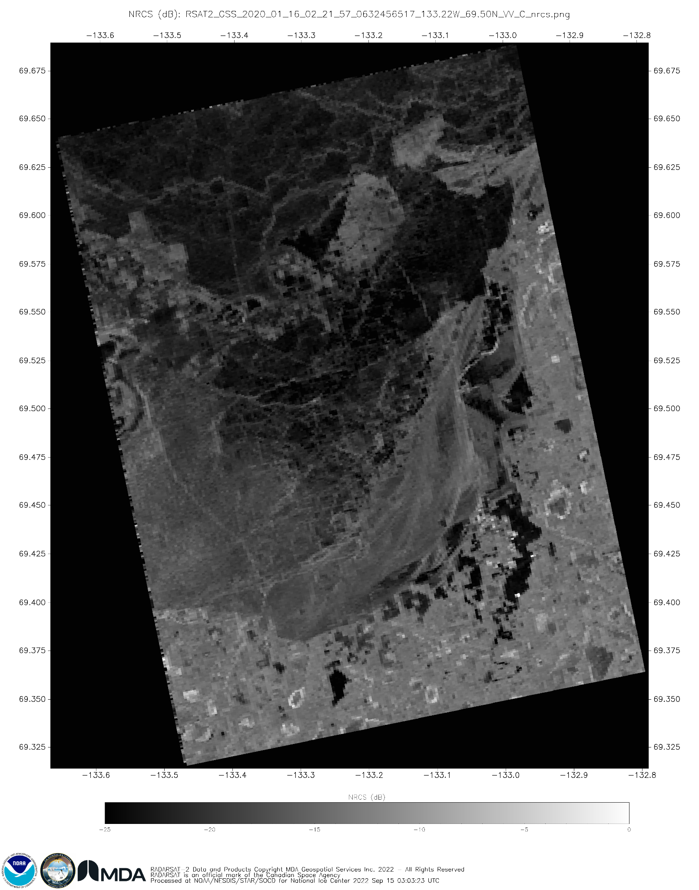
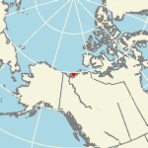
Polarization
HH Polarization
VV Polarization
Radarsat-2
16 January 2020 02:22 UTC
Sea Ice and Coastal Canada

Slide 21
Polarization
HH Polarization
VV Polarization
Radarsat-2
16 January 2020 02:22 UTC
Sea Ice and Coastal Canada
Backscatters HH polarized signals well
Backscatters VV polarized signals poorly

Slide 22
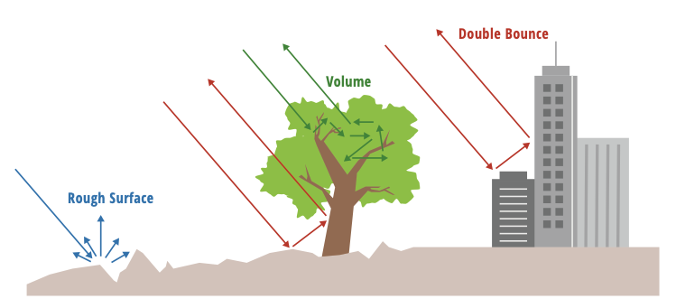
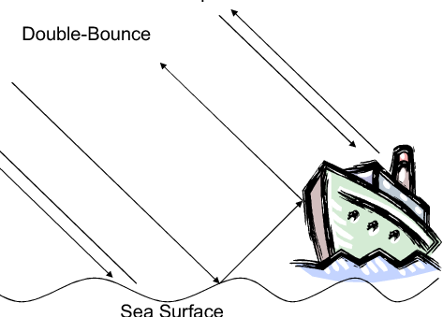
SAR Scattering and Polarization
Examining these different polarizations carries information about the structure of the imaged surface, based on the following types of scattering and how surfaces interact with polarized beam:
Rough surface scattering (single bounce):
Sensitive to VV scattering. Used for surface wind speeds.
Volume (multiple bounce) scattering:
Volume scattering, (e.g.caused by the leaves and branches in a forest canopy) is most sensitive to cross-polarized data like VH or HV.
Double bounce scattering:
double bounce, is caused by buildings, tree trunks, or inundated vegetation and is most sensitive to an HH
https://ntrs.nasa.gov/api/citations/20190002563/downloads/20190002563.pdf

Slide 23
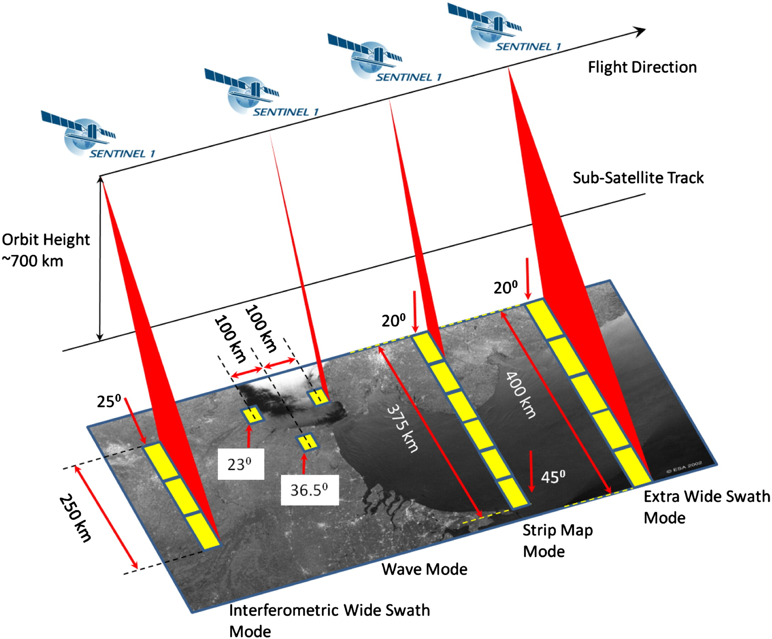
Sentinel-1 is the current generation of SAR
The latest generation of SAR have very sophisticated capabilities offering a wide variety of data collection modes
For a SAR on a polar-orbiting satellite, this imagery can have fine spatial resolution of <100 meters over a swath that can be as wide as 500 kilometers
Tradeoffs between coverage area and resolution
Imaging Modes for Sentinel-1
Beam Mode | Swath | Incidence Angle (deg) | Bean Information
Stripmap (SM) | 80 km | 18.3 - 46.8 | Has 6 possible positions
Interfermoetric Wide (IW) | 240 km | 29.1 - 46 | Composed of 3 sub -swath
Extra Wide Swath (EW) | 410 km | 18.9-47 | Composed of 5 sub-swaths

Slide 24
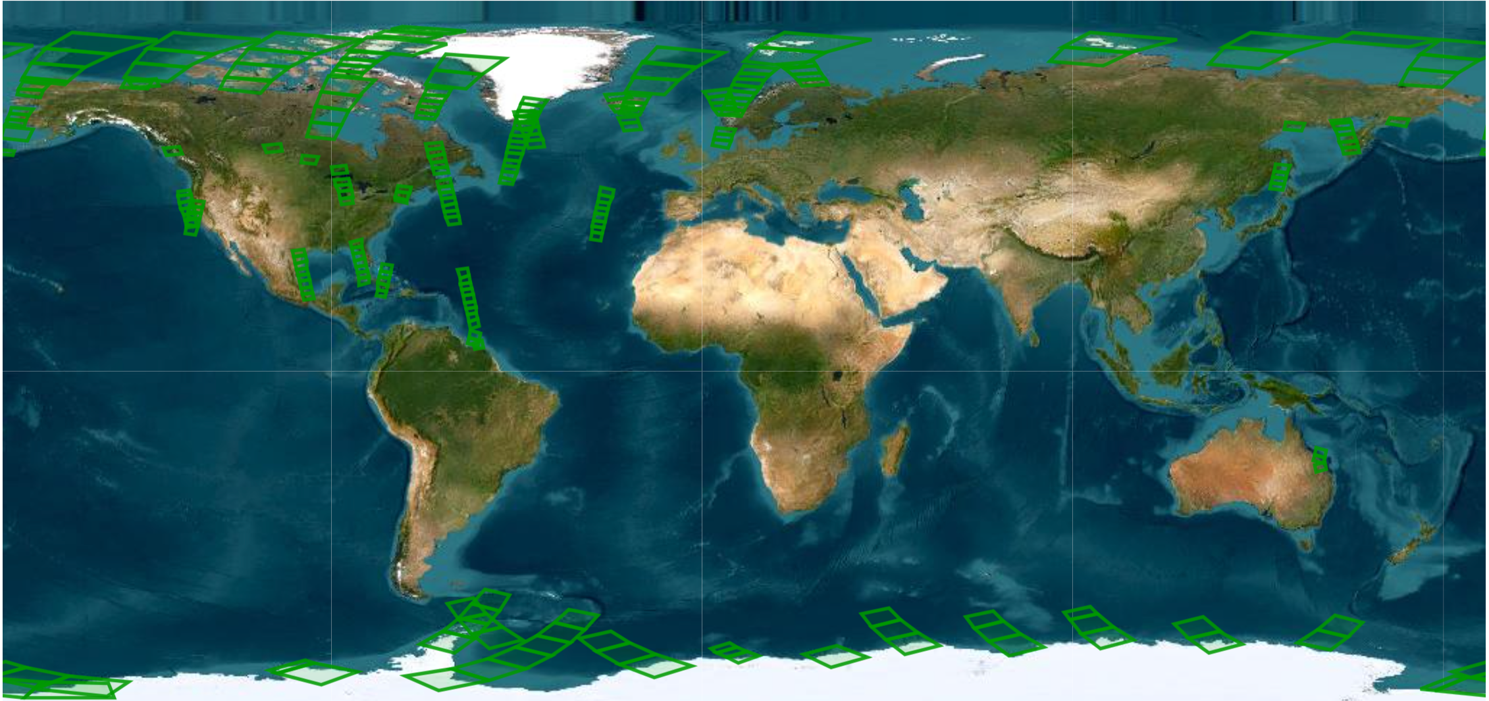
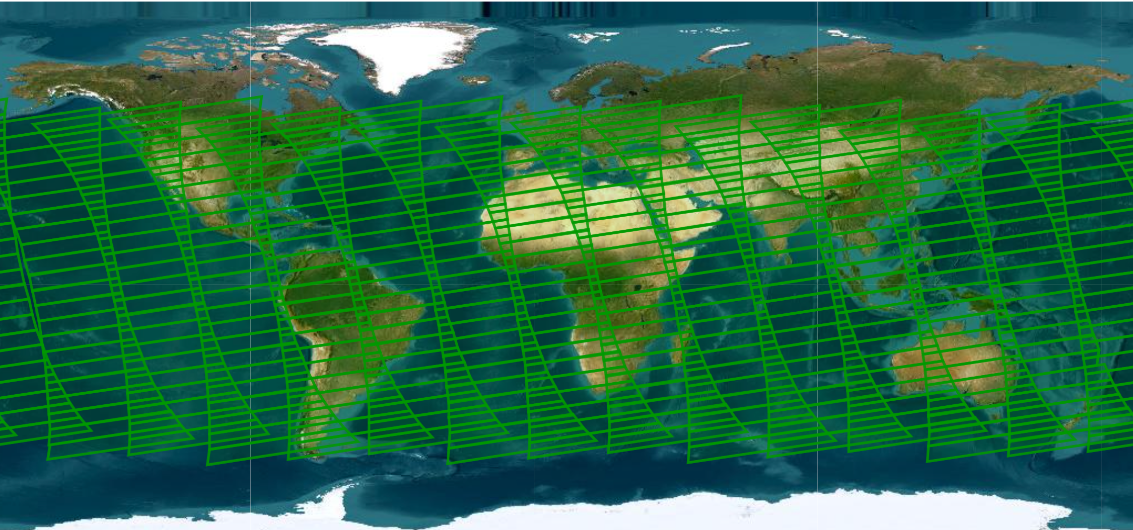
Comparison of a Sentinel-1(SAR) and VIIRS-SNPP (Ocean Color)
Sentinel-1: Scenes collected, 29 March 2021+
VIIRS SNPP: Scenes collected, 29 March 2021*
SAR data is collected in small footprint over only a portion of an orbit.
Limited by power, duty cycle and data volume
 | Sentinel-1 | VIIRS-SNPP
Swath width | 40-400 km | 3000 km
Spatial resolution | 5-100 m | 750 m
Revisit time - Polar - Mid-latitudes | <1-3 days 12 days | multiple/day 2 times/day
Minutes of collection/orbit | 25 min | continuous
Scenes/day | 600 | 240
+Additional S1 scenes over Europe and Asia are not shown
*VIIRS collections over the North and South pole are not shown
3000 km swath, 750 m, continuous (6min sectors)

Slide 25
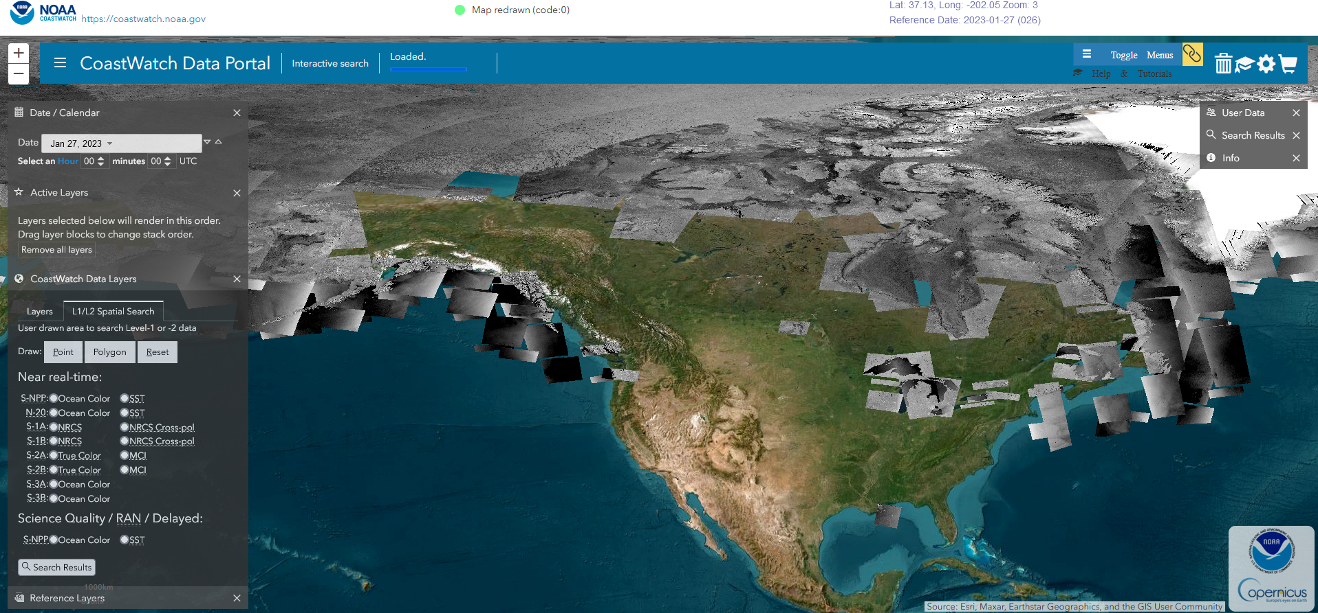
SAR Data at CoastWatch
Sentinel-1 SAR imagery (since 2018) around the U.S. and the Arctic are available at CW
The data are in NetCDF format and can be previewed with PNG images
https://coastwatch.noaa.gov/cw_html/cwViewer.html

Slide 26
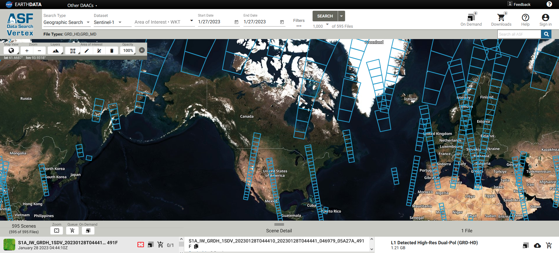
SAR Data at Alaska Satellite Facility
The Alaska Satellite Facility Data Archive host data from a variety of SAR sensors (Sentinel-1, ALOS-1, ERS).
The data are available in a variety of formats
Specialized software is needed to read the native data formats
Requires registration with NASA (free) to download the imagery.
https://search.asf.alaska.edu/#/

Slide 27
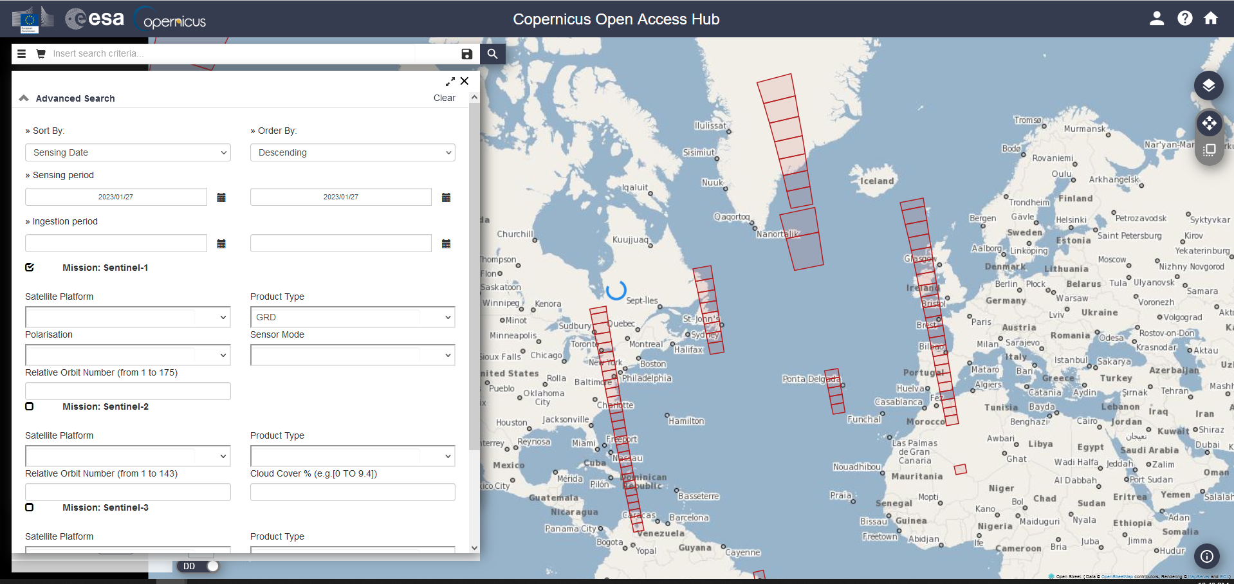
Sentinel-1 Data at ESA’s Copernicus Scientific Data Hub
Sentinel-1 imagery are available at the Copernicus Scientific Data Hub.
The data are available in the S1 native format (xml/geotiff)
Requires registration to download the imagery.
https://scihub.copernicus.eu/dhus/#/home

Slide 28
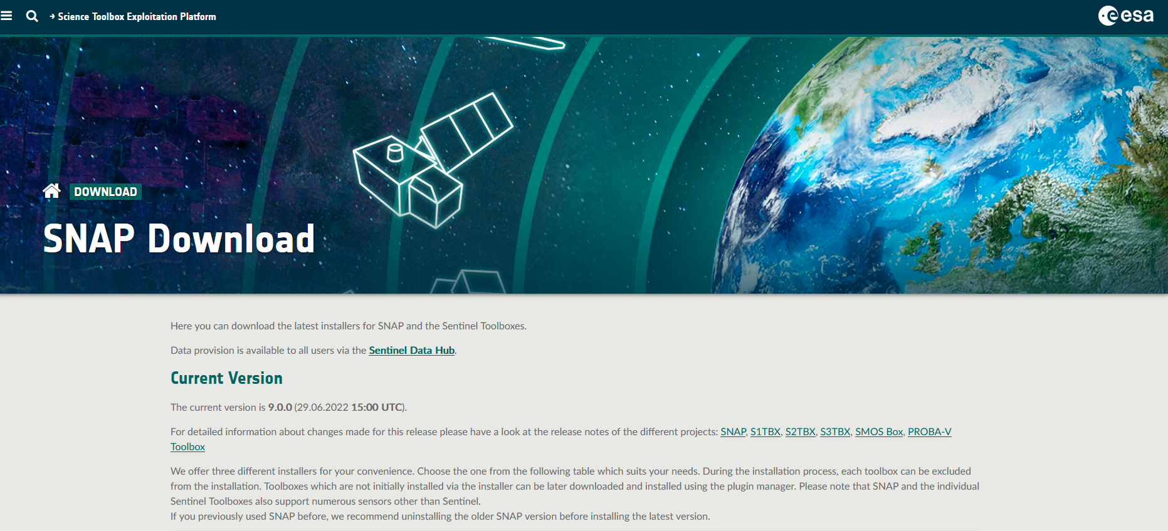
SNAP Toolbox for SAR data
https://step.esa.int/main/download/snap-download/
SNAP will read the native format of most SAR system
Users can calibrate and manipulate the data (sub-set or composite)

Slide 29
References and other online trainings
https://www.star.nesdis.noaa.gov/socd/mecb/sar/publications.html
https://ntrs.nasa.gov/api/citations/20190002563/downloads/20190002563.pdf
https://www.earthdata.nasa.gov/learn/backgrounders/what-is-sar
https://earth.esa.int/eogateway/missions/ers/radar-courses/radar-course-1
https://appliedsciences.nasa.gov/join-mission/training/english/arset-introduction-synthetic-aperture-radar
https://eo-college.org/courses/echoes-in-space/

Slide 30
The CoastWatch Synthetic Aperture Radar instructional series
The CoastWatch Synthetic Aperture Radar (SAR) instructional series
consists of three (3) training modules:
  Module 1: An overview of SAR (this module)
  Module 2: Descriptions of available SAR products and where to find them
  (in development)
  Module 3: Examples of how various phenomena appear in SAR imagery
  (in development)

